Slide 1

Broad-casting
Dr. S.F.Rodd
Professor, Dept. of CSE, GIT

Slide 2
Broad-casting
Broadcasting in computer network is a group communication,
where a sender sends data to receivers simultaneously.
This is an all − to − all communication model where each
dending device transmits data to all other devices in the network
domain

Slide 3
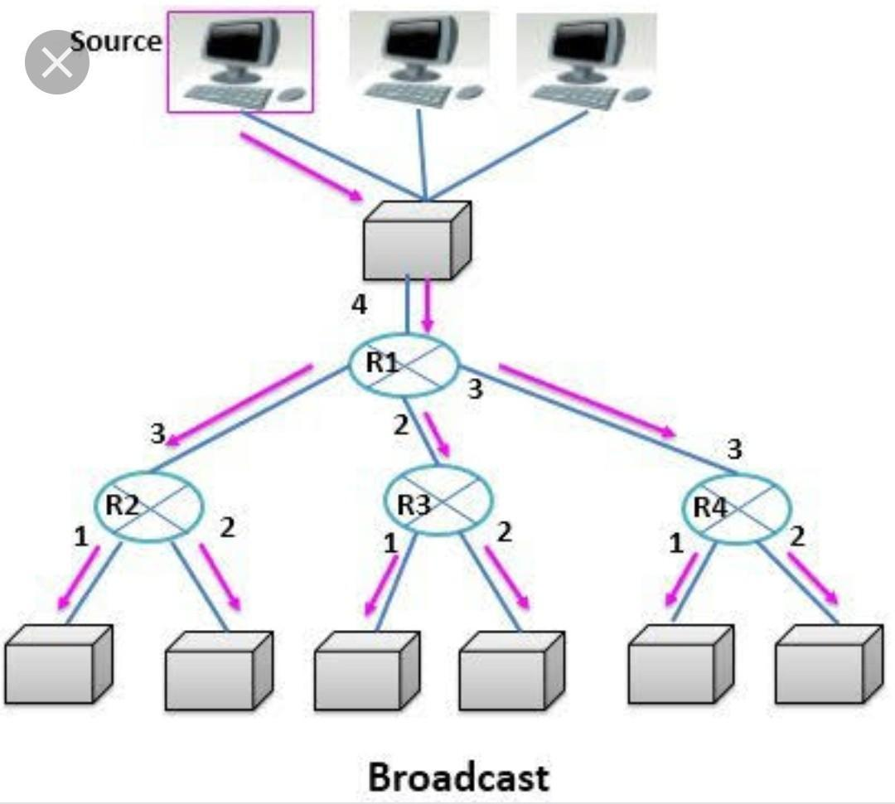
Broadcasting

Slide 4
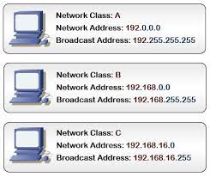
Broad-cast address

Slide 5
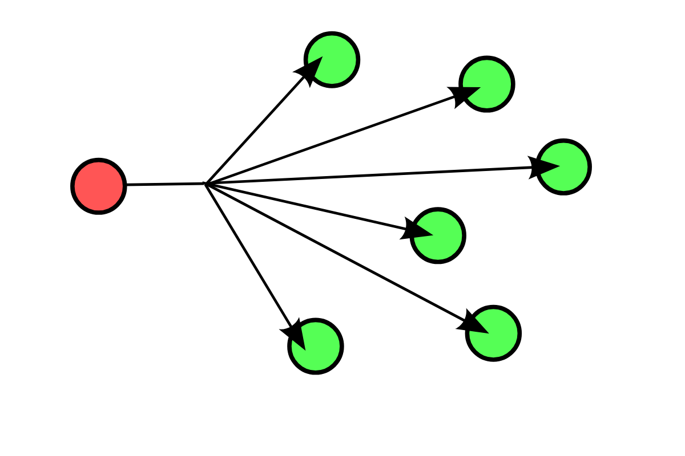
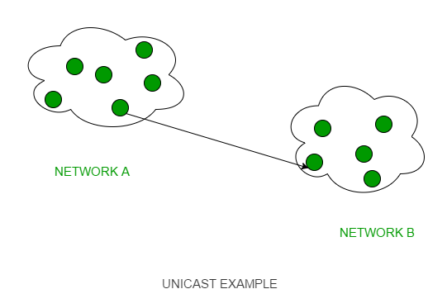


Uni-cast V/s Broadcast
Broad-Cast 1-to-Many(All)

Slide 6
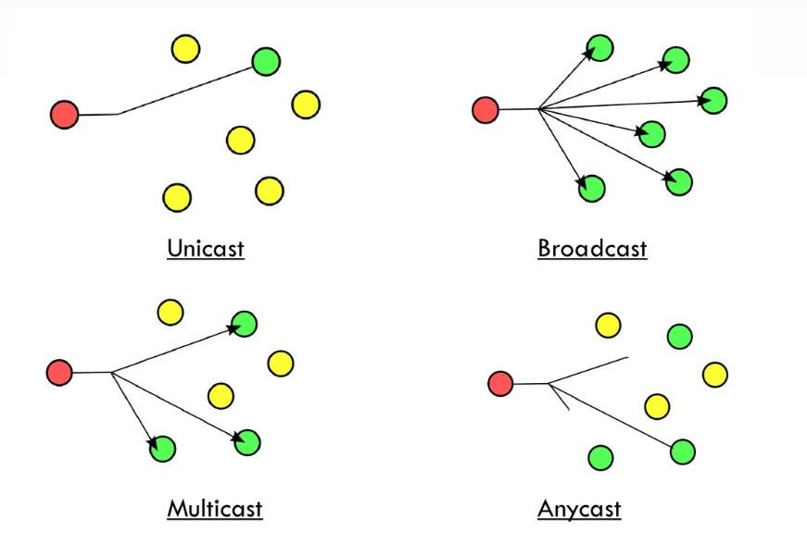
Unicast, Multicast and Broadcast and Anycast

Slide 7
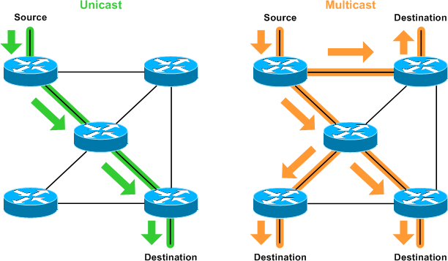
Unicast, Multicast and Broadcast a comparison

Slide 8
PIM – Protocol Independent Multi-cast
The term "protocol-independent" stems from the fact that PIM
does not maintain its own topology database. Instead, it relies
on the unicast forwarding table of the router to avoid loops;
PIM is considered protocol-independent because it has no
direct dependency on the unicast routing protocol(s) used.

Slide 9
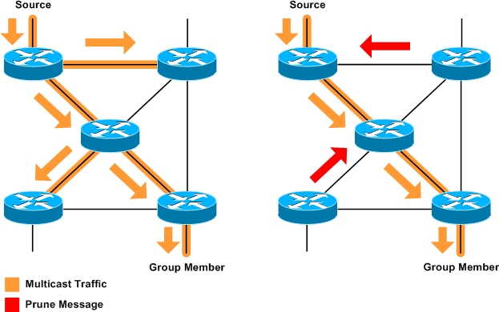
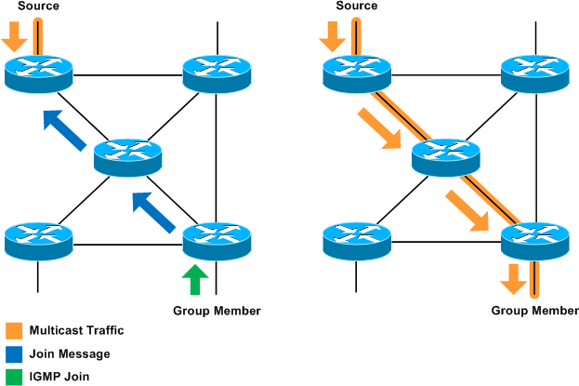
PIM – Protocol Independent Multi-cast
PIM – Dense Mode… PIM – Sparse Mode
PIM-DM PIM -SM

Slide 10
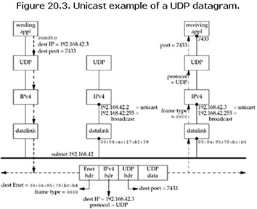
Uni-cast V/s Broadcast
192.168.42.3
192.168.42.3

Slide 11
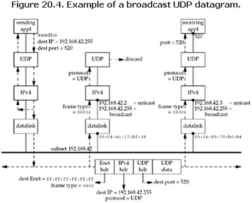
UDP Echo… dg_Cli
192.168.42.255
192.168.42.255
192.168.42.255
192.168.42.255

Slide 12
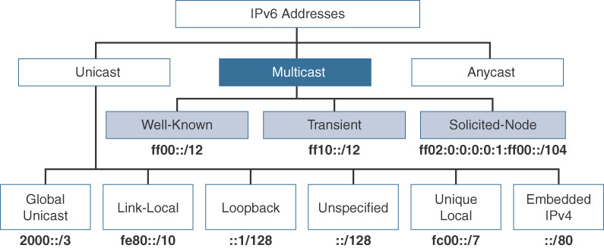
Address Space-IPV6 – Multi-cast address space

Slide 13
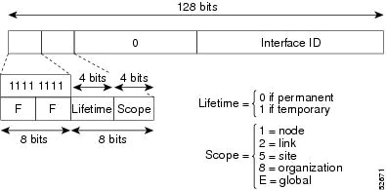
Address Space-IPV6

Slide 14
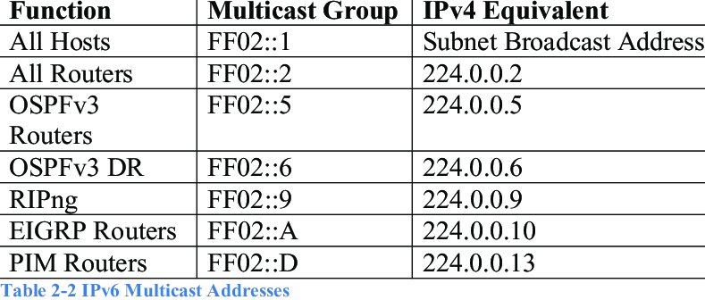
Address Space-IPV6

Slide 15
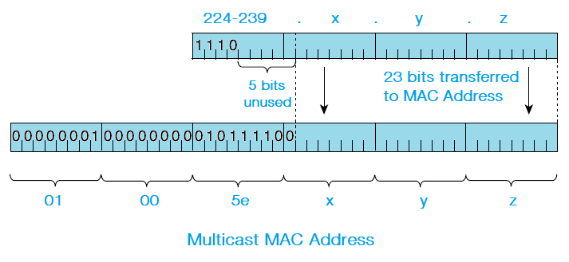
Address Space-IPV4

Slide 16
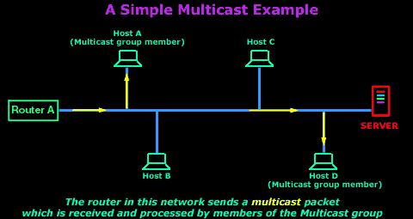
Multi-cast on LAN

Slide 17
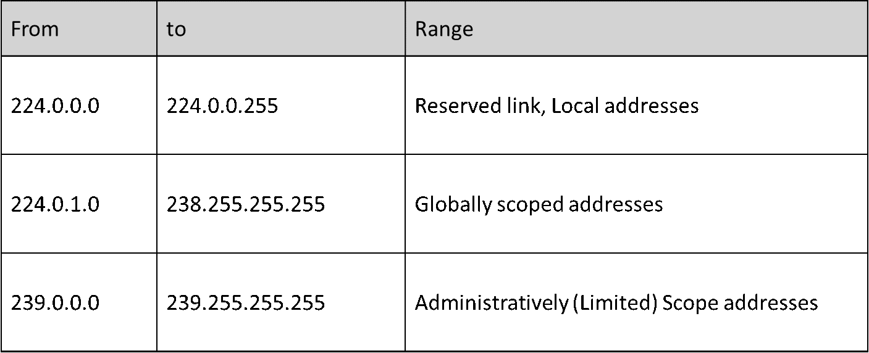
Address Space-IPV4

Slide 18
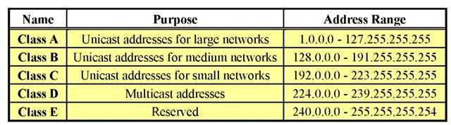
Multi-cast Addresses – IPV 4

Slide 19
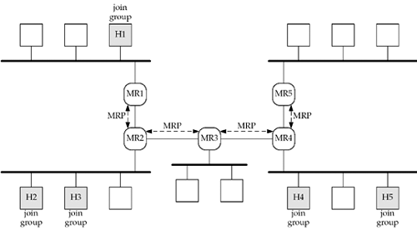
Mult-casting on WAN
sender

Slide 20
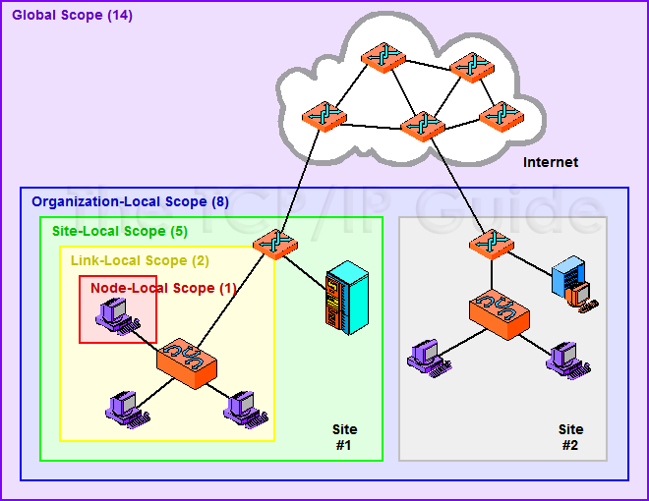
Scope of Multi-cast Addresses

Slide 21
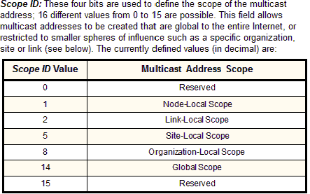
Scope of Multi-cast Addresses

Slide 22
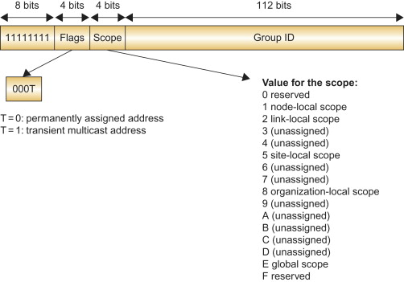
Scope of Multi-cast Addresses

Slide 23
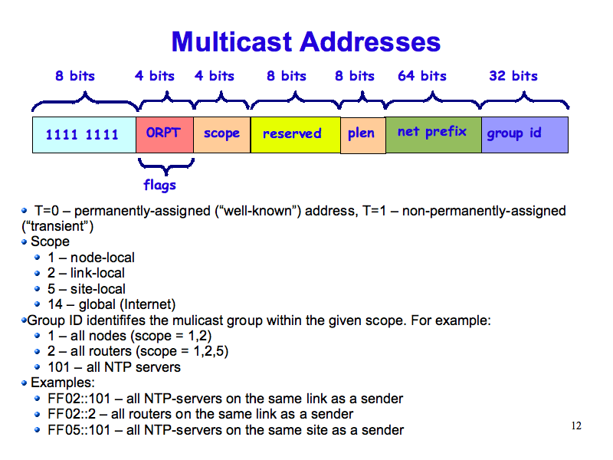
Scope of Multi-cast Addresses

Slide 24
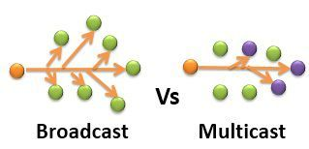
Multicasting
Multi-cast Group

Slide 25
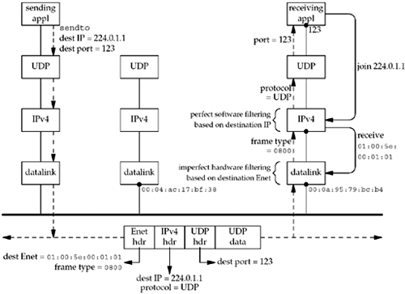
224.0.1.1
224.0.1.1

Slide 26
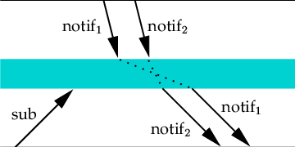
Race condition in Broadcasting
In networking, a race condition occurs when two or more try to access the same channel.

Slide 27
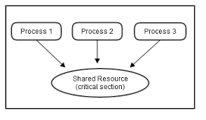
Race condition

Slide 28
Race condition

Slide 29
Multi-cast v/s Broadcast
The receiving application on the rightmost host starts and creates a UDP socket, binds port 123 to the socket, and then joins the multicast group 224.0.1.1.
The "join" operation is done by calling setsockopt. When this happens, the IPv4 layer saves the information internally and then tells the appropriate datalink to receive Ethernet frames.
The next step is for the sending application on the leftmost host to create a UDP socket and send a datagram to 224.0.1.1, port 123. Nothing special is required to send a multicast datagram:
The application does not have to join the multicast group. The sending host converts the IP address into the corresponding Ethernet destination address and the frame is sent.

Slide 30
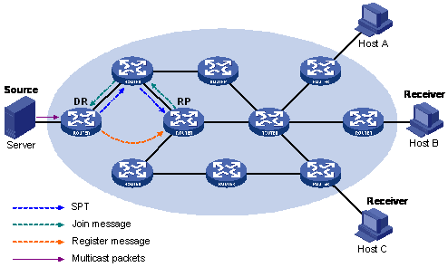
Any Source Multi-cast
S
(S, G)
(*, G)

Slide 31
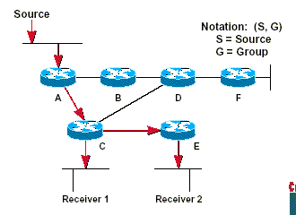
Source Specific Multi-cast
S,G
S,G

Slide 32
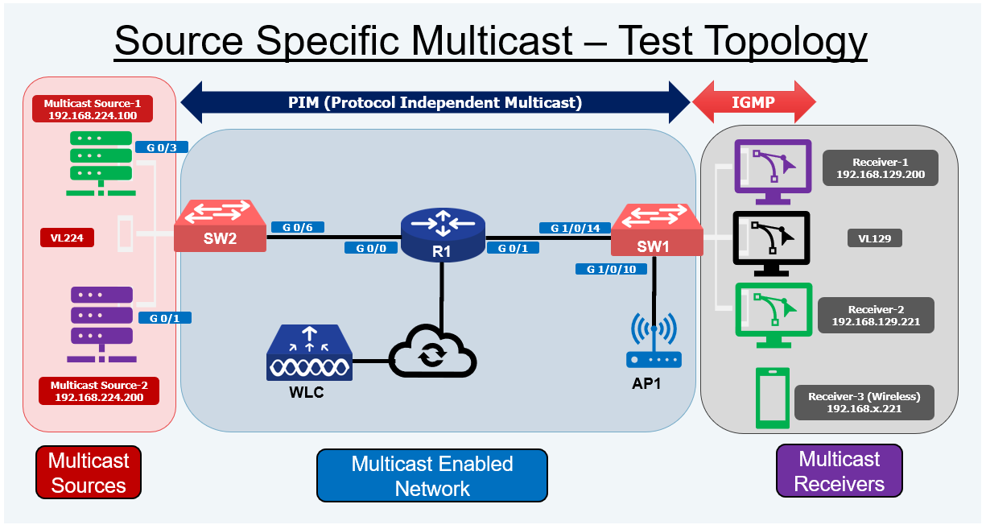

Slide 33
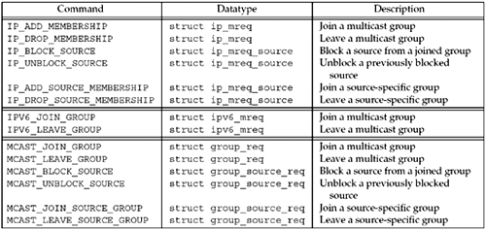
Multi-cast Socket Options

Slide 34
SNTP
Simple Network Time Protocol (SNTP) is a simplified version of Network Time Protocol (NTP) that is used to synchronize computer clocks on a network. This simplified version of NTP is generally used when full implementation of NTP is not needed.

Slide 35
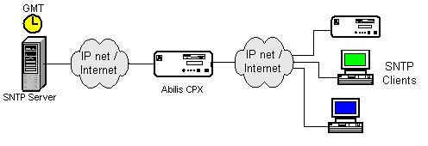
SNTP

